Slide 1
Logic gates using MUX

Slide 2
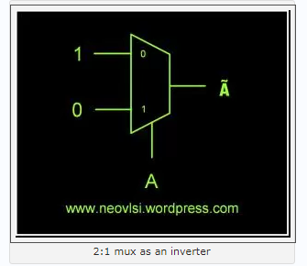
Designing an Inverter using 2:1 MUX.

Slide 3
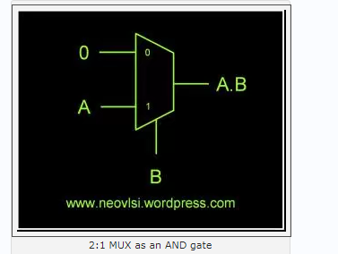
Designing an AND Gate using 2:1 MUX.

Slide 4
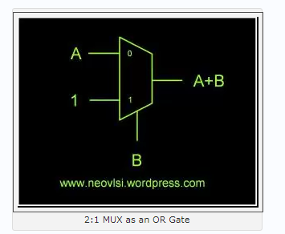
Designing an OR Gate using 2:1 MUX.

Slide 5
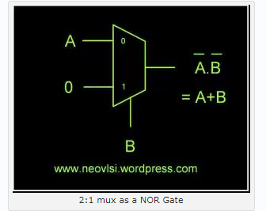
Designing an NOR Gate using 2:1 MUX.

Slide 6
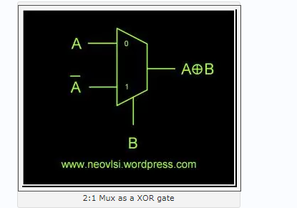
Designing an XOR Gate using 2:1 MUX.

Slide 7
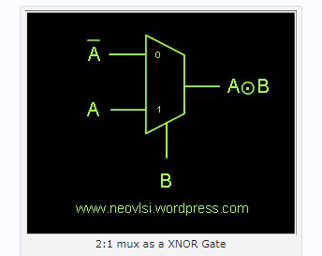
Designing an XNOR Gate using 2:1 MUX.

